Slide 1

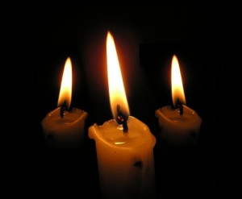
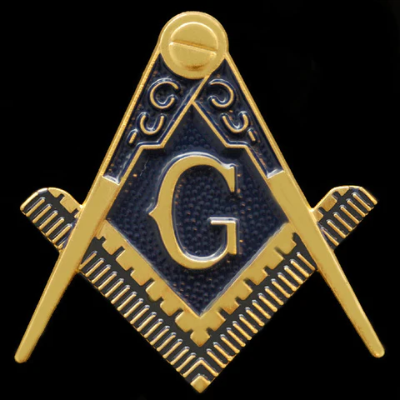
The Lesser Lights
The unexplained symbols of the Lodge

Slide 2
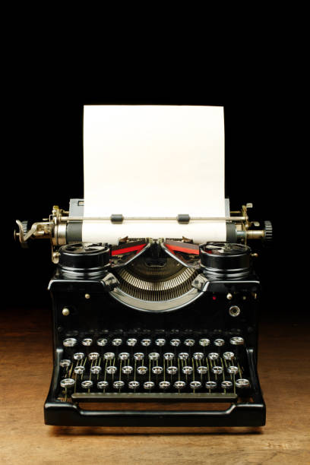
What is the proper and best description for our type of Lodge?
We are a
Symbolic Lodge
Mason’s Lodge
Symbolic Lodge
Blue Lodge
Holy Saint’s John Lodge
Notes:
Back in 1990 a.

Slide 3
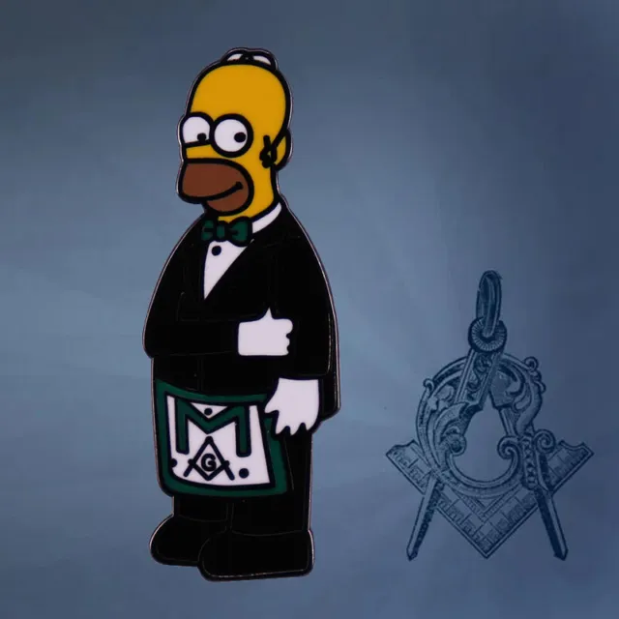
In many instances, our symbols and symbolism
Are poorly explained if they are explained at all!
This may be by design to make us think!

Slide 4

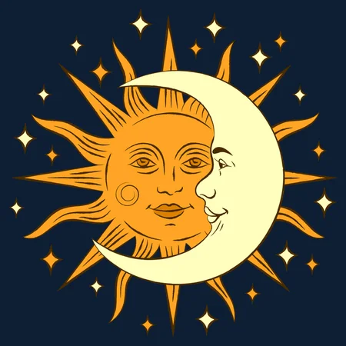
Genesis 1:16
“And God made two great lights; the greater light to rule the day, and the lesser light to rule the night; he made the stars also.”

Slide 5
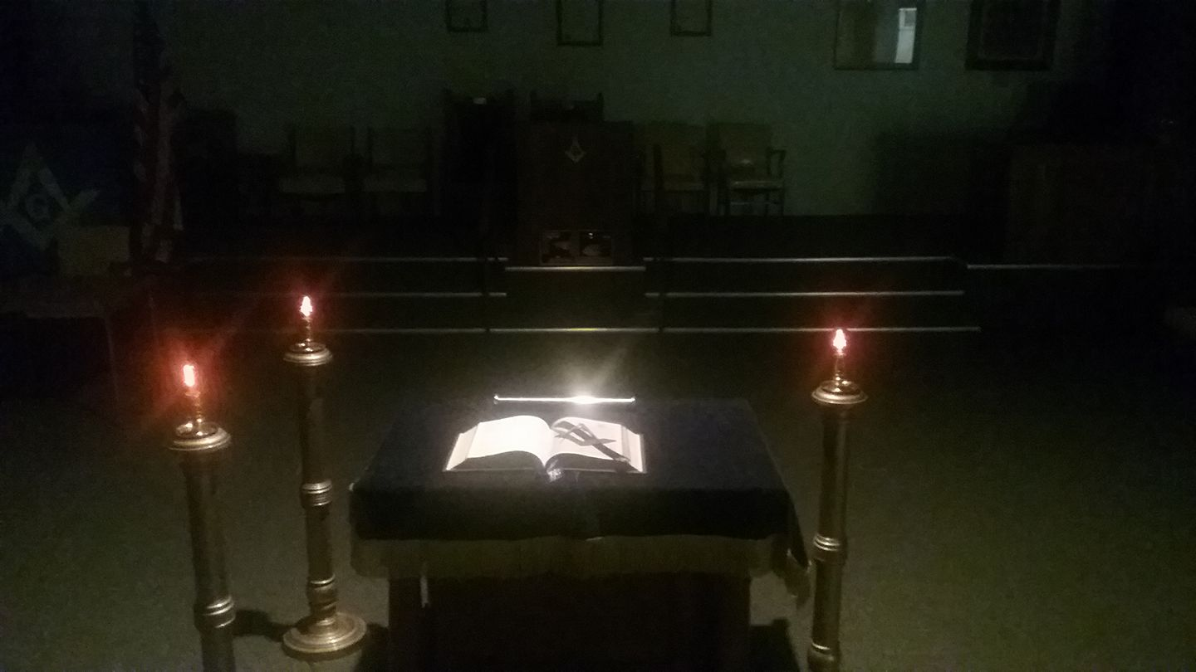
Picture a Masonic Lodge without electricity
For most of our history, our Lodges were lit at night by
A candle at each of the officers stations
The lesser lights around the altar

Slide 6
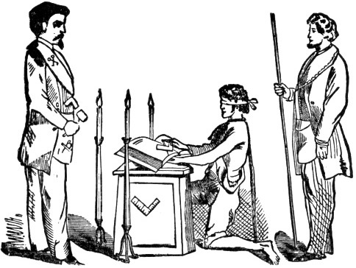
When an initiate
is first brought to light in a Masonic Lodge, the radiance comes from the three Lesser lights, which form a triangle about the Altar.

Slide 7
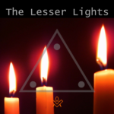
It seems, at first,
rather odd that so great and important a symbol should receive such scant attention in the ritualistic body of Freemasonry.

Slide 8
Our EA Lecture
We are instructed that they are called Lesser Lights, that they are placed in a triangle,

Slide 9
Our EA Lecture
that they represent the Sun and Moon and Master of the Lodge, for certain reasons, which are rather briefly explained, and that is all.

Slide 10
Later on we learn, more by example
Than by precept,
that Lesser Lights are always lit when a lodge is opened.
And are extinguished when the lodge is closed and the Great Lights displaced.
Notes:
They are supposed to be lighted as soon as the lodge is opened and the Altar arranged; to be extinguished when the lodge is closed and the Great Lights displaced.

Slide 11
Buts that’s it. There in nothing more!
Look through many a Masonic volume and tome and find no more light on the Lesser lights than the ritual provides.
Even Albert Mackey, the great Masonic authority, is unusually brief on the subject.
Notes:
And yet it could not be possible. that so important a symbol could have no more soul than is given in the few words we devote to it.

Slide 12
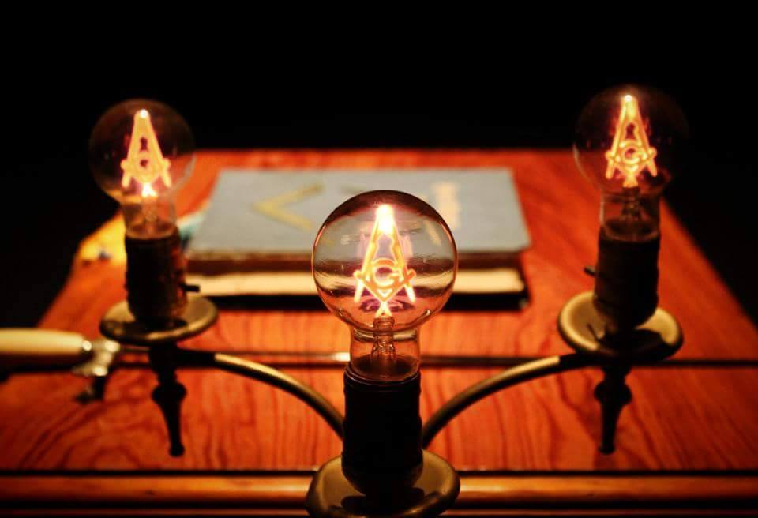
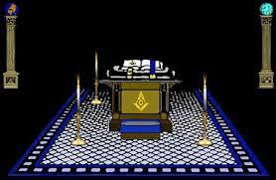
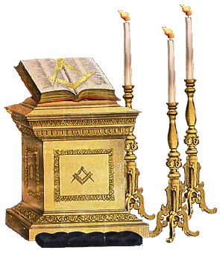
Let us dig a little deeper together
Immediately after the Lesser Lights are named, our attention is directed to the fact that they are in a triangle about the Altar.
Notes:
In some Jurisdictions they are closely about the Altar; in others, one is placed at each of the stations of the three principal officers. In some lodges the three Lesser Lights form a right angle, in others an equilateral triangle & in even others an isosceles triangle.

Slide 13
But why three? Why not four? Or more?
Think about how many three’s (triads) there are in the Lodge
The number 3 was the most sacred to the Pythagoreans – it was the number of God, therefore, the triangle becomes a symbol for God
Notes:
What is uniform throughout the Masonic world is the triangular formation about the Altar; what is different is the size and shape of the triangle. Of course it is not possible to place three lights to form anything else but a triangle; they cannot be made to form a square or a star. Which brings us to the first place in which to dig and sink our Masonic shovel; why are there THREE Lesser Lights and not two or four or more? There are a number of reasons.
Triads: principle officers, degrees, knocks, to open a lodge, steps to the east, great lights, etc.

Slide 14
The triangle is
as God was always considered as First, and also as without either beginning or ending, the triangle itself soon became a symbol of Deity.
the first possible figure made up of straight lines, which is without beginning or ending.
Notes:
which is the first possible figure made up of straight lines, which is without beginning or ending. One line, or two lines, have ends. They start and finish. The triangle, like the square or the five or more sided figure, has no loose ends, and the triangle is the first of these which can be made; as God was always considered as First, and also as without either beginning or ending, the triangle itself soon became a symbol of Deity. A reminder that God is the heart of the brotherhood

Slide 15
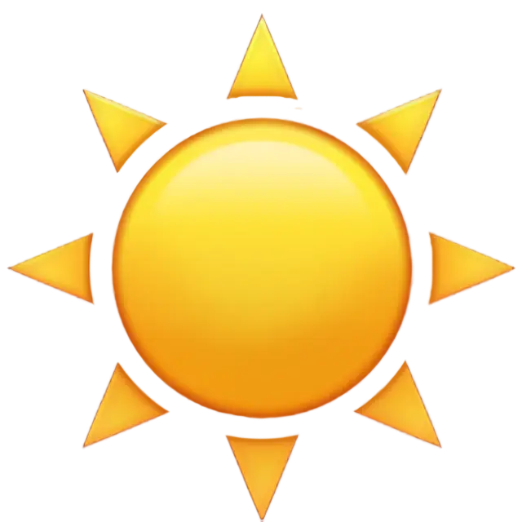
But why the sun as a lesser light?
Sun worship was among the first of religions of ancient peoples;
early worshipers would set a light beside their altar or holy place and name it for the sun.
it was the source of light and life!
Notes:
Archaeologists have found countless examples of this over the entire globe. Everywhere can be found pictograms, stone carvings, megalithic structures, and temples dedicated to the sun and the moon. And not just in prehistoric times, even more modern cultures, from the Egyptians, Greeks, Romans, and beyond have continued that reverence for these two bodies. Even today this continues, but maybe not as obviously; in the Western world we reference the sun and the moon every week with our calendar system, after all, is not SUNday followed by MOONday?

Slide 16
Ancient peoples made much of sex.
and the savage worshiper of a shining god in the sky too required a mate;
especially when that mate was so plainly in evidence;
the moon became the Sun’s bride by a process of reasoning as plain as it was childlike.
Notes:
Their two greatest impulses were
self preservation and mating.
Their third was protection of children

Slide 17
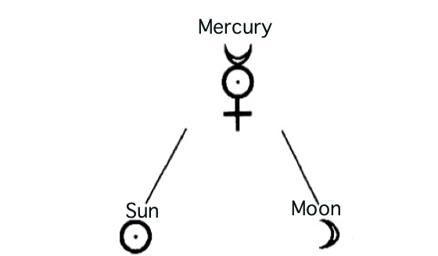
Sun and moon had a child
That child was Mercury, the nearest planet to the sun, the one god kept closest to him

Slide 18
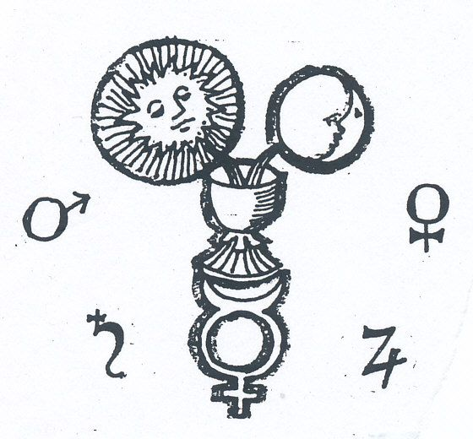
Here we have the origin of the . . .
three Lesser Lights;
in recorded accounts of the Mysteries of Eleusis (to mention only one) we find three lights about the holy place, representing the Sun, the Moon and Mercury.
Notes:
They are considered the most famous of the secret religious rites of ancient Greece

Slide 19
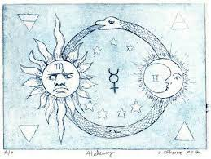
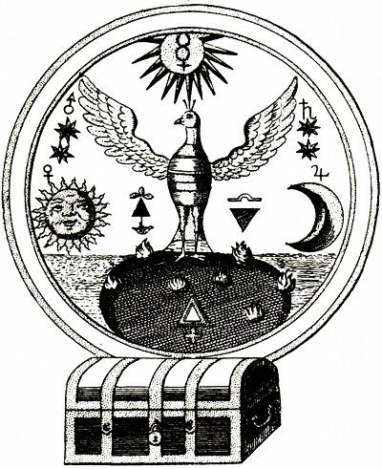
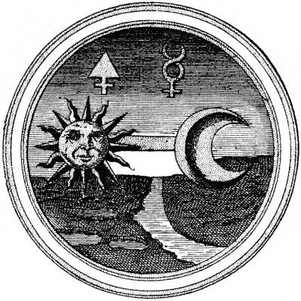
It is unclear
When the Master of the Lodge was substituted for Mercury as the third lesser light

Slide 20
Pritchard’s Expose of 1730
Q. Have you any Lights in your Lodge?
A. Yes, Three.
Q What do they represent?
A. Sun, Moon and Master-Mason.
N.B. These Lights are three large Candles placed on high Candlesticks.

Slide 21
Albert Pike says:
“They are still the Three Lights of a Masonic Lodge, except that for Mercury, the Master of the Lodge has been absurdly substituted.”
Notes:
Albert Pike was a very great and very learned man. To him Freemasonry owes a debt greater, perhaps than to any other who ever lived; he gave her study, he brought forth her poetry, he interpreted her symbols, he defined her truths, he made plain much that she had concealed. But Pike himself defended the right of all Masons to study and interpret the symbols of Freemasonry for themselves. So that it is with no thought of controversy with the immortal dead that many contend that there is no absurdity in Freemasonry taking the ancient lights which symbolize Sun and Moon and Mercury and making them stand for Sun and Moon and Worshipful Master of His Lodge.

Slide 22
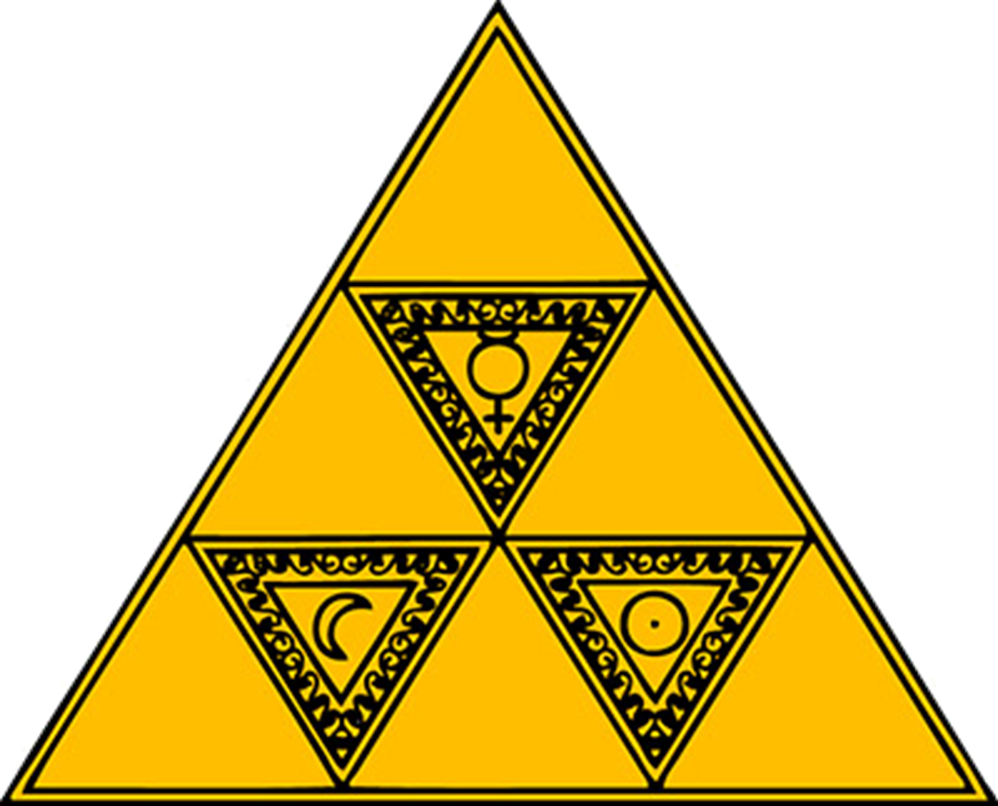
Alchemical signs for gold, silver, and mercury
Signs for the Sun, Moon, and Master of the Lodge

Slide 23
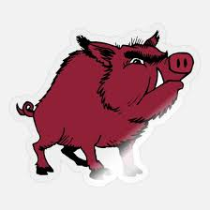
Modern Masonic writers have stated
The Worshipful Master rules and governs his lodge as truly as the Sun and Moon rule and govern day and night.
There can be no lodge without a Worshipful Master;
he is in a very real sense the lodge itself!

Slide 24

Attention all Worshipful Masters!!
It is one of the principal functions of the Worshipful Master to disseminate light –Masonic light (Knowledge and instruction) to his lodge.
That the duty is often honoured by neglect as by performance, has nothing to do with the fact that it is a duty!

Slide 25
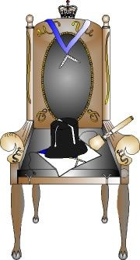
The Worshipful Master is
A giver of light to his brethren.
So the inclusion of the Worshipful Master, as a lesser light is both right and proper.
Notes:
So that the inclusion of a symbol of the Worshipful Master, as a giver of light, is to most of us neither fanciful nor absurd, but a logical carrying out of that Masonic doctrine which makes a Master the Giver of Light to his brethren.

Slide 26
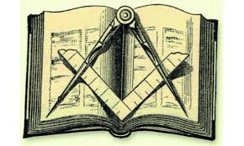
This is an actual fact, but it is also a symbol
The Great Light cannot be read without light; the Square and Compasses cannot be used in the dark, neither can they be understood;

Slide 27
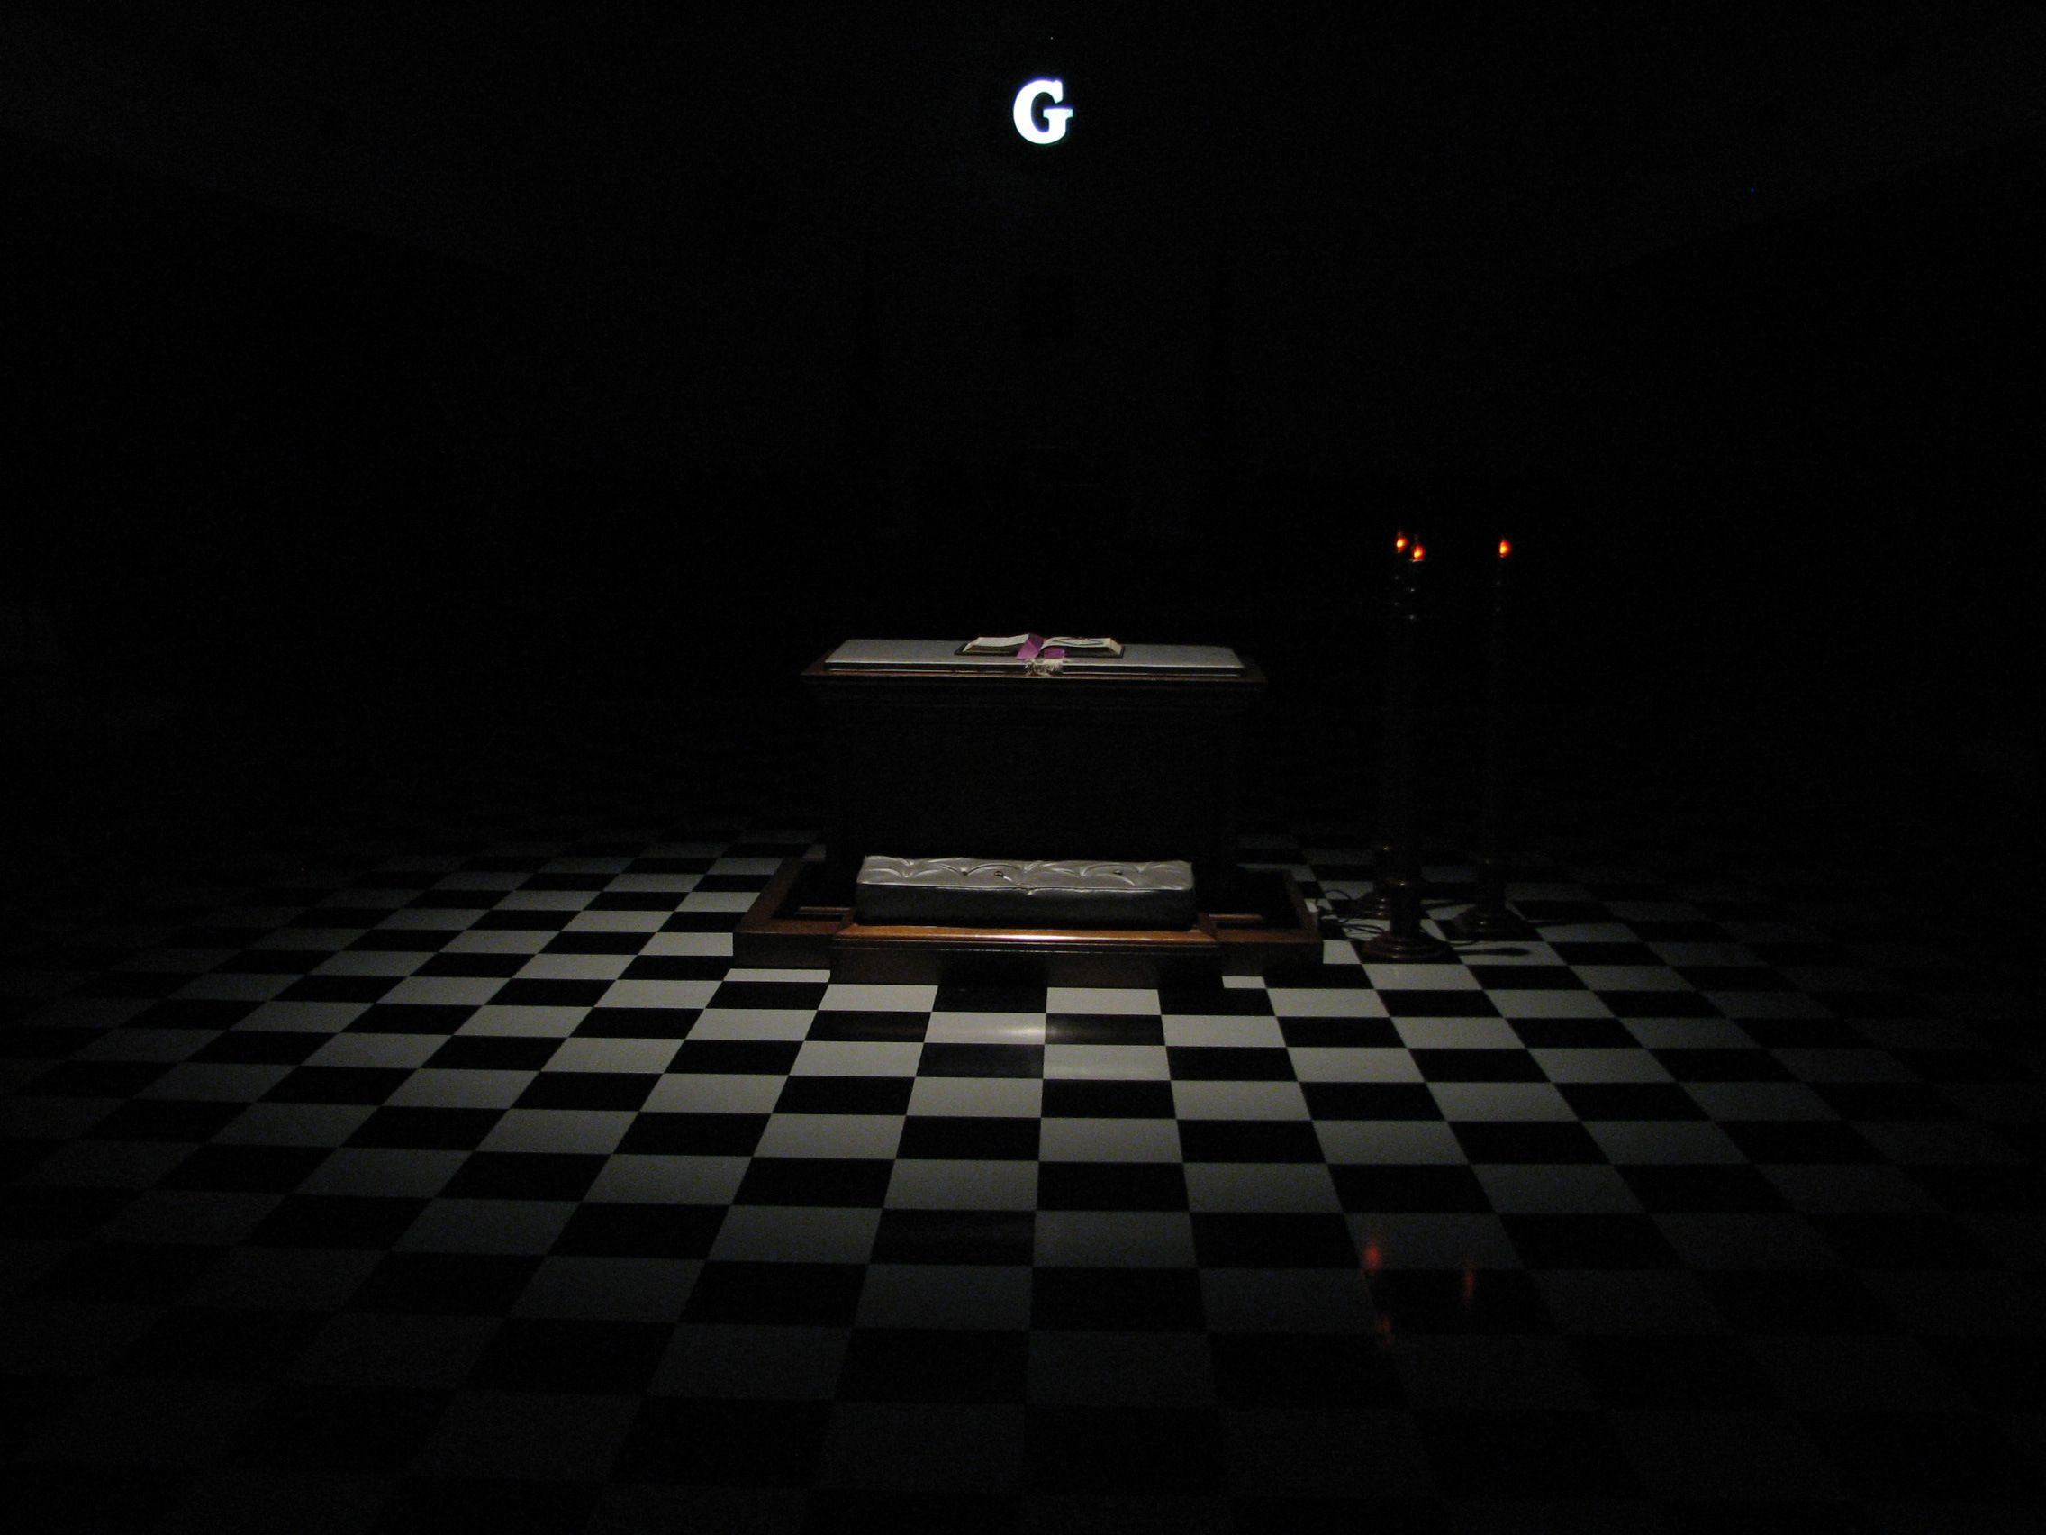
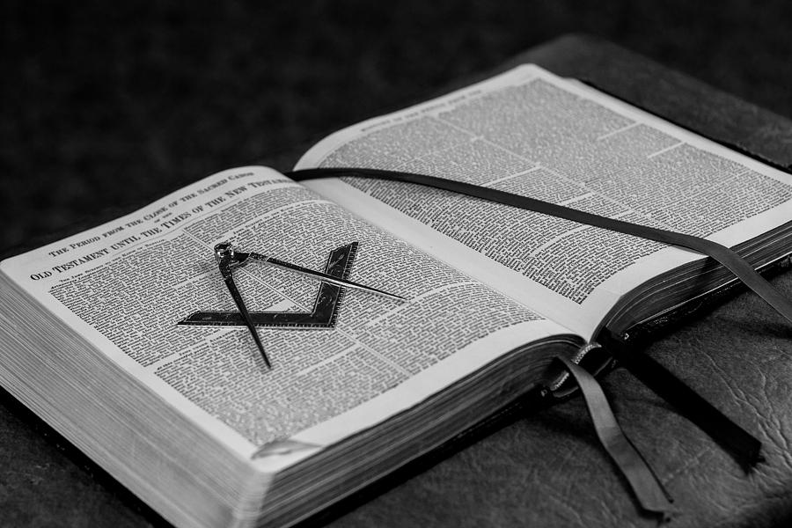
The ritual instructs candidates
that they behold the Great Lights of Masonry because of the illumination of the Lesser Lights.

Slide 28
We cannot make use of the Great Lights
for the noble and glorious purpose taught us in Speculative Masonry, unless we receive symbolic light, Masonic light, from the East . . .
Notes:
Triangular form - A reminder that God is the heart of the brotherhood

Slide 29
That is, from the Worshipful Master
“ to set the Craft to Labor with good and wholesome instruction, or cause it to be done, . . . . that he might have pleasure, and the Craft profit thereby!

Slide 30
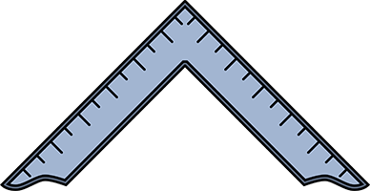
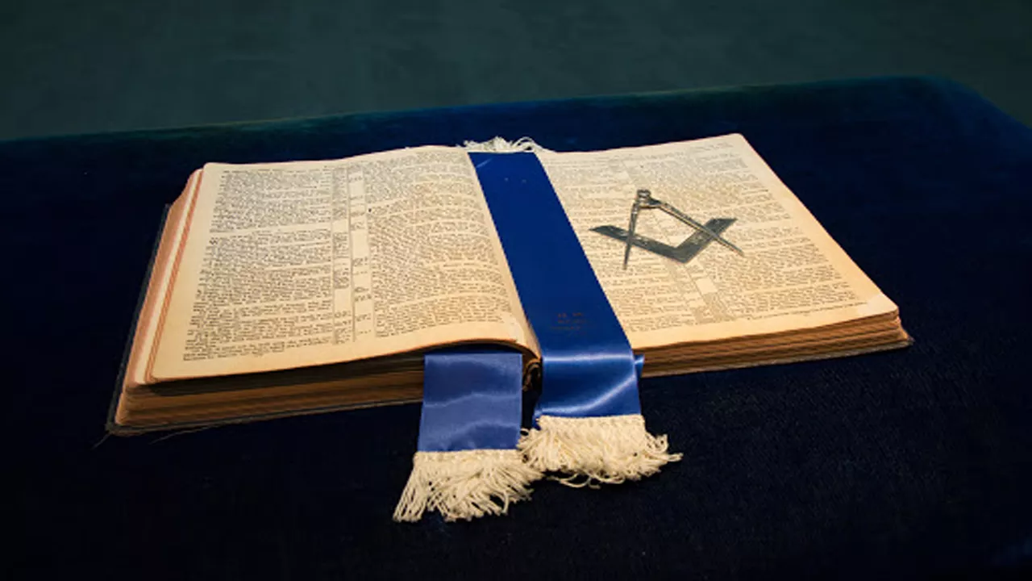
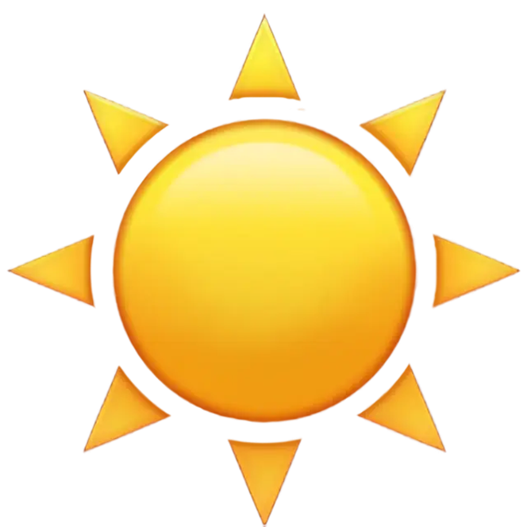
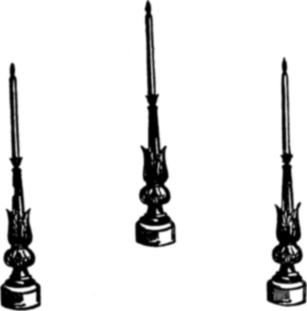
Notes:
The square represents morality, as Freemasons need to "square [their] actions by the square of virtue with all mankind". The compass measures the ability to wisely conduct actions within certain boundaries.

